Slide 1
Hydrogen Prospector Database Demo
An Approach to Evaluating LWR Plant Integration with Hydrogen and Industrial Facilities
INL, ANL, and University of Michigan
Kathleen P Sweeney
Gabrielle Hoelzle
6/21/2024

Slide 2
Attendees Jason Marcinkoski – DOE Federal Program Manager Richard D. Boardman – FPOG Pathway Lead Todd Knighton – Principal Investigator Team Maria A. Herrera Diaz Gabrielle Hoelzle Kathleen P. Sweeney Adarsh P. Bafana Neeraj C. Hanumante Kevin Daley Craig Primer

Slide 3
Agenda
Background
Goals and Objectives
Project Timeline
Introduction to the Demo~Scenarios
Future Work

Slide 4
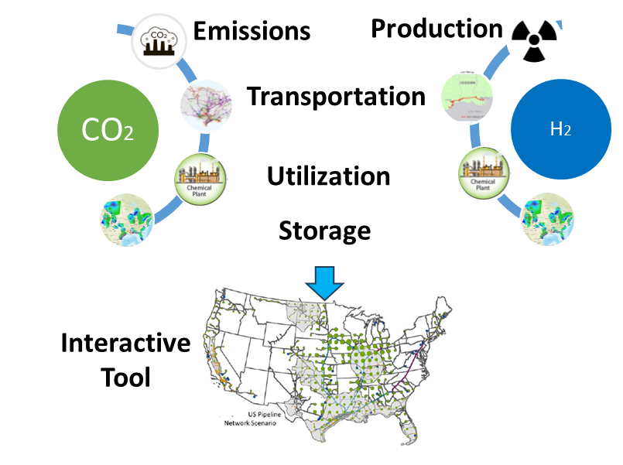
Background
Assessing opportunities for hydrogen and carbon dioxide capture, transport, utilization, and storage infrastructure is vital for meeting current and future energy and industrial sector demand needs to reach net-zero.

Slide 5
Goals and Objectives
Future Work: Cost and Business Case Analysis
Current and future needs of CO2 and H2 infrastructure Close to the LWR
Define potential business cases and estimate their economic feasibility and business cases for different systems of carbon and hydrogen
Evaluate the current capacity, project the future infrastructure
Tool Development for Infrastructure Mapping
Demonstration
Evaluate 3 scenarios to analyze hydrogen production opportunities
.
Develop a database which provides useful output for decision makers evaluating opportunities for nuclear integrated hydrogen production

Slide 6
Project Timeline
Milestone Category | Title | Oct | Nov | Dec | Jan | Feb | Mar | Apr | May | Jun | Jul | Aug | Sep | Status
M4 | Complete a Plan for a data base approach to evaluating LWR plants for coupling with a hydrogen plant and other industrial plants |  |  |  |  |  |  |  |  |  |  |  |  | Completed
M4 | Complete Incorporation of carbon resource(s) supply options |  |  |  |  |  |  |  |  |  |  |  |  | Completed
M3 | Complete a demonstration of a prospector database to evaluate and select the leading top five opportunities for LWR hydrogen plant |  |  |  |  |  |  |  |  |  |  |  |  | Work in Progress
M2 | Provide public release data base for use by utilities to investigate hydrogen production and local-specific markets |  |  |  |  |  |  |  |  |  |  |  |  | Work in Progress

Slide 7
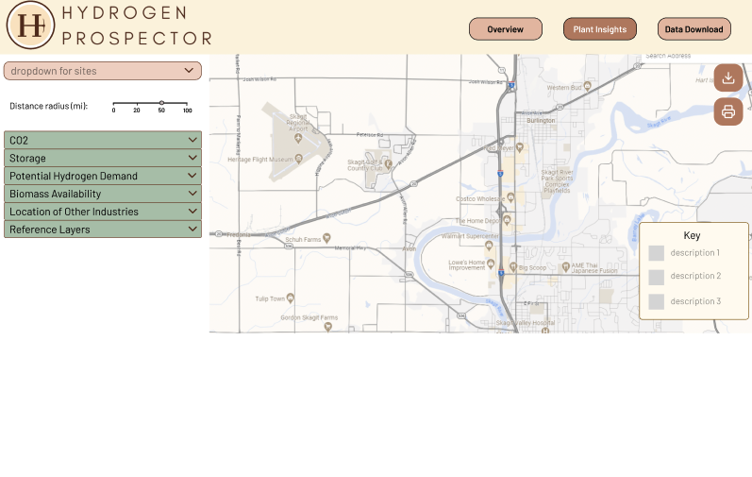
Prospector Tool Dashboard (in progress)

Slide 8
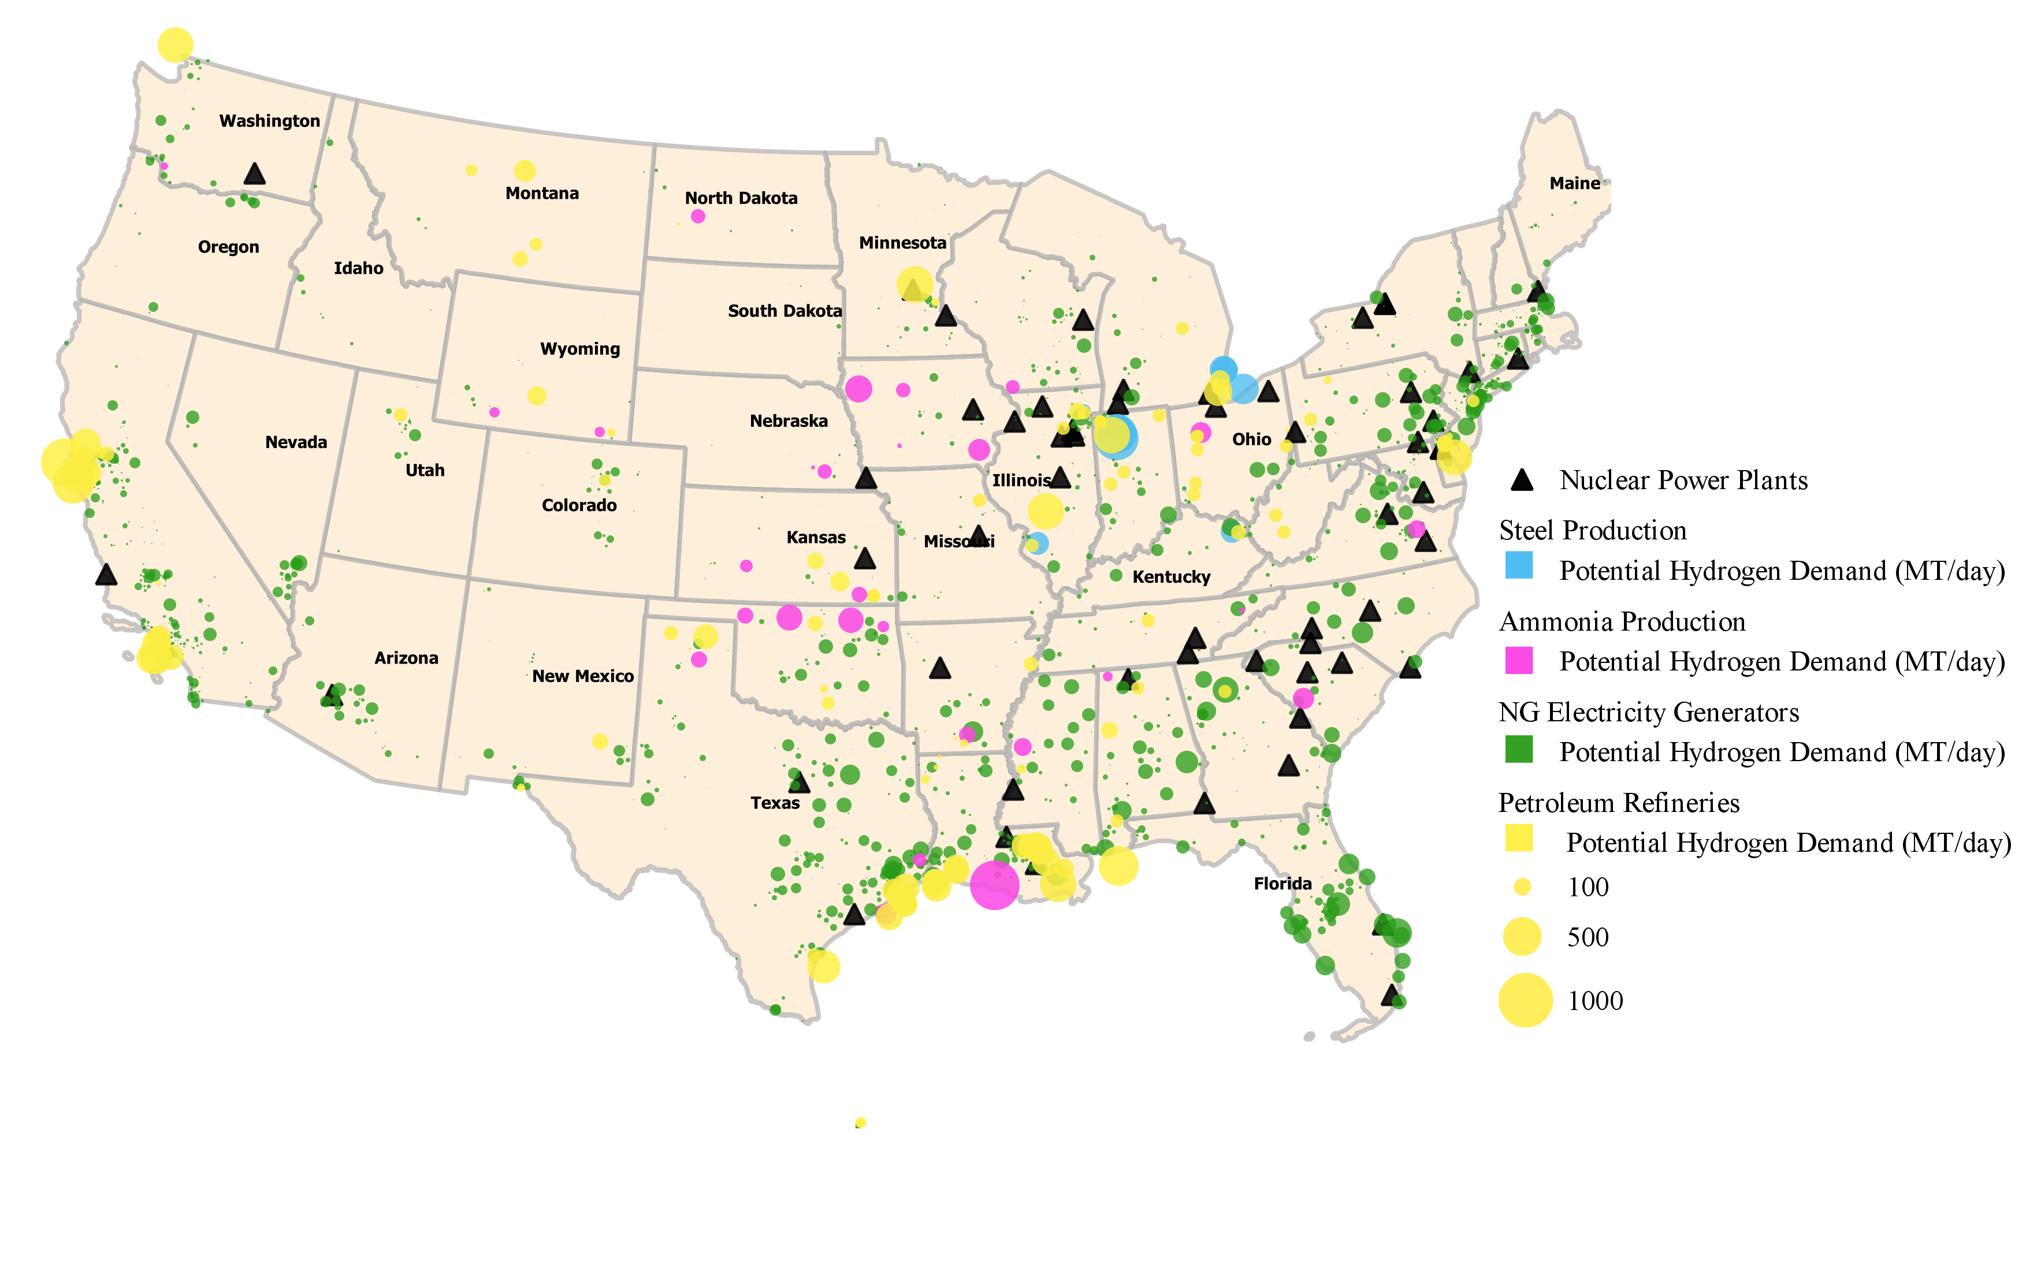
Infrastructure & Demand Data Compilation
Potential hydrogen demand estimates
Tier 1: Existing facility and users
-Refineries and ammonia
Tier 2: Existing facility and potential user
-H₂ Blending for NG Electricity Generators, Steel Production
Tier 3: Future industries
-E-Fuels etc.

Slide 9
Infrastructure & Demand Data Compilation
Distance between NPP and closest H₂ and NG pipeline infrastructure
Location of geological storage: Salt domes/cavern, unused oil and gas well etc.
CO2 source, amount, and location

Slide 10
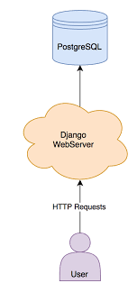
Database to Application

Slide 11
Introduction to the Demo~Scenarios
01
Rank existing LWR sites for Tier 1 with largest potential hydrogen demand within 25 miles
-Potential emission reduction possible for using nuclear-electrolytic H2 for Tier 1 facilities
Database and Prospector Tool Demonstration
Randomly select 50 potential sites for new SMRs and rank by total potential hydrogen demand within 25 miles
02
03
Provide attribute data for Gulf Coast LWRs
-Total potential hydrogen demand within 25 miles
-Distance to existing pipelines

Slide 12
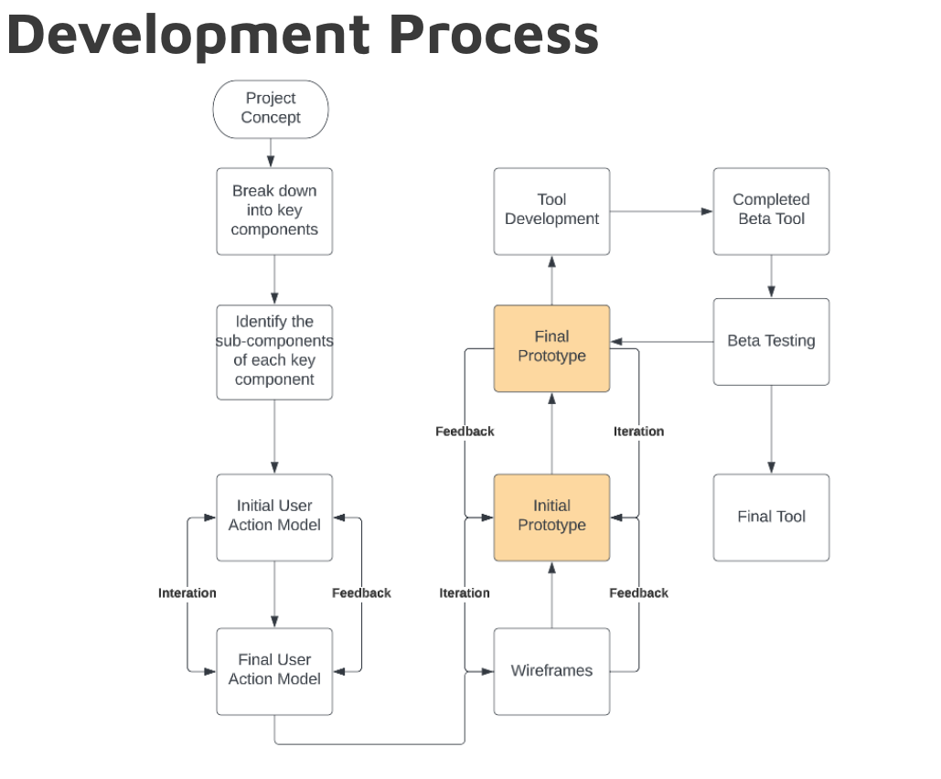

Slide 13
DEMO

Slide 14
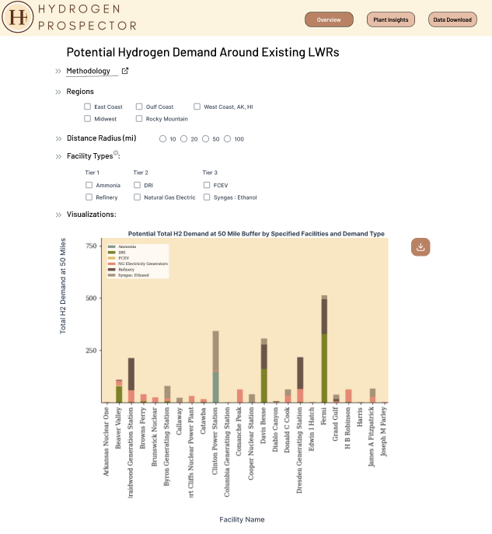
Application Landing Page
Provides Users a Regional Overview of Hydrogen Demand

Slide 15
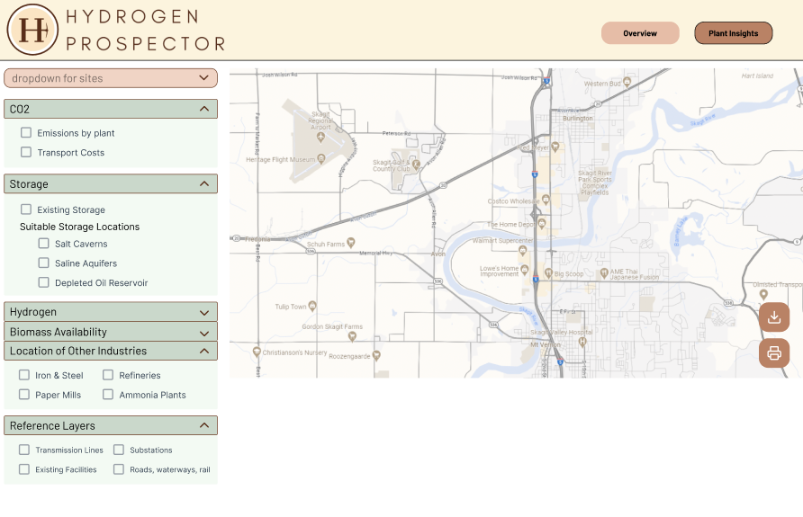
Mapping Component: Overview
Web GIS – Allows users to choose relevant spatial layers (in green), and see the data in the interactive map located on the right side of the tool.

Slide 16
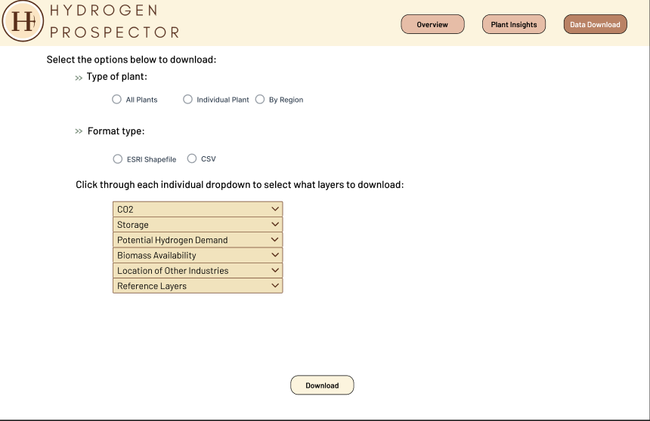
Data Download
Users can download selected data in multiple formats for use in other applications /research.

Slide 17
FY24 Accomplishments
M4 Completed (October)- developed a plan for the database
M4 Completed (April)- data gathering for carbon resources, transport and storage (including biomass)
M3- data mining for hydrogen and CO2 demand, storage, and transportation infrastructure, demonstration of the database

Slide 18
FY24 Ongoing Work
Finalize prototype
Continue developing new data streams
Improve modeling capabilities
Complete tool development
Complete beta testing
Release final tool to public

Slide 19
Future Work
Geographically expand datasets for full coverage of the US
Evaluation of synfuels production
Implement more sophisticated modeling to draw broader conclusions
Leverage STAND policy components and expand to include policy/incentives around existing LWRs and new hydrogen facilities
Add risk assessment

